Slide 1
SC462 Elements of Synthetic Biology
Prof. Manish K Gupta
Winter 2017
DA-IICT
CRISPR and HIV

Slide 2
Group Members :-
• 201401047 - Nachiket Trivedi
• 201401138 - Dhaval Prajapati
• 201401438 - Adwait Gandhi
• 201401444 - Vatsal Thakkar
• 201401456 - Mihir Limbachia

Slide 3
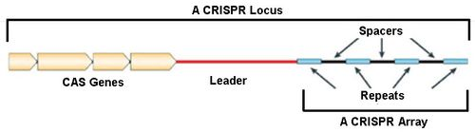
CRISPR and Cas protein
First discovered in E. Coli.
Clustered Regularly Interspaced Short Palindromic Repeats
Main role of crispr is to provide immunity

Slide 4
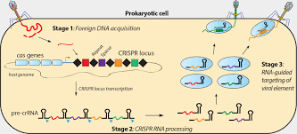
CRISPR and Cas protein
They also contain CRISPR associated genes, better known as CAS genes
Whenever an external bacteriophage attacks the bacteria cell, the first trigger is done by cas genes.

Slide 5
CRISPR and Cas protein
The cell analyzes the DNA released by the virus/bacteriophage and checks if it has the similar DNA in the CRISPR sequence.
Thus the CRISPR is searched for injected DNA sequence by bacteriophage in its spacer DNAs

Slide 6
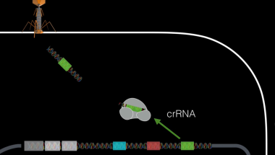
CRISPR and Cas protein
Lets take case 1 where there exists a spacer DNA such that it matches with the injected DNA of the bacteriophage.

Slide 7
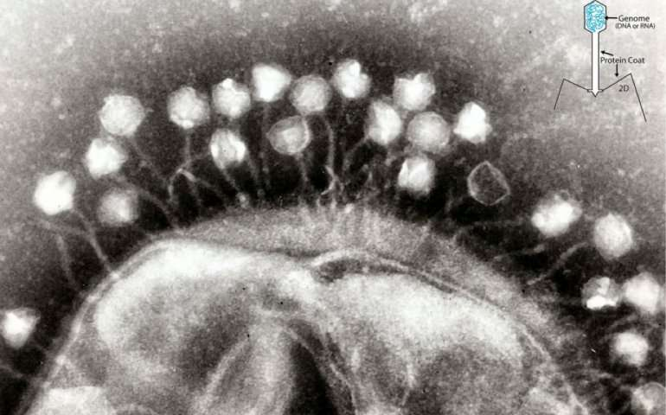
CRISPR and Cas protein
Now lets take another example where the CRISPR doesnt contain a matching spacer DNA.

Slide 8
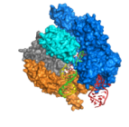
CRISPR-Cas9 System
As cripsr was inside a cell, scientists thought to hijack a cas protein and modify it such that it fulfills some useful requirements
Cas9 system developed by Jennifer Doudna, Emmanuelle Charpentier et al.
To hold the crRNA, it has another tracer RNA represented as tracrRNA

Slide 9
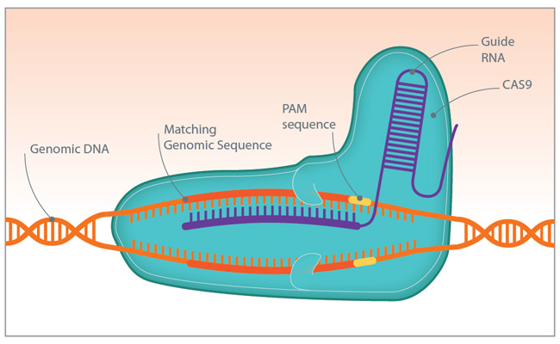
CRISPR-Cas9 System
Cas9 is just one protein which is just derived from a slight modification of the cas protein.
This fusion of two RNA sequences to form a chimera is often called guide RNA or gRNA.

Slide 10
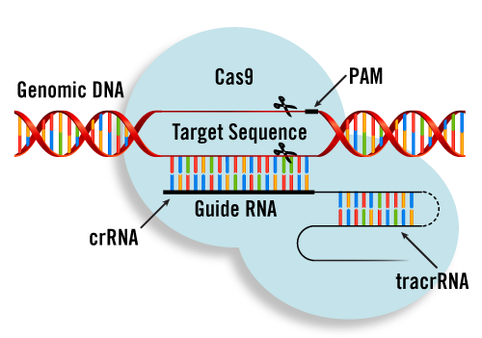
CRISPR-Cas9 System

Slide 11
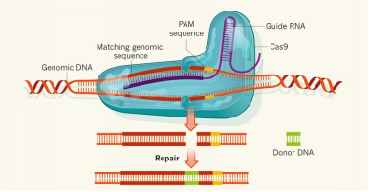
CRISPR-Cas9 System
Lets keep a DNA sequence which we want to insert in the incoming DNA sequence where the matching with crRNA takes place

Slide 12
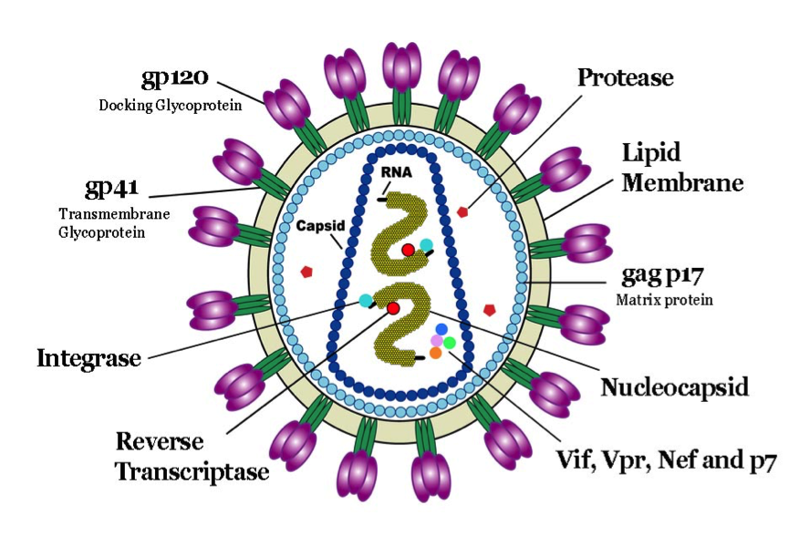
`
HIV
Structure of HIV
HIV consists of 9 cells.
It is composed of two strands of RNA, 15 types of viral proteins, and a few proteins from the last host cell it infected, all surrounded by a lipid bilayer membrane.

Slide 13
`
HIV
Structure of HIV
hiv is a member of a class known as Retroviruses. These viruses store their genetic information as ribonucleic acid (RNA), unlike most viruses which store their genetic information as deoxyribonucleic acid (DNA). Before viral replication can take place, the RNA must be converted to DNA by reverse transcription, hence the Latin term Retro, meaning 'turning back'.
hiv comprises an outer envelope consisting of a lipid bilayer with spikes of glycoproteins (gp), gp41 and gp120. These glycoproteins are linked in such a way that gp120 protrudes from the surface of the virus. Inside this envelope is a nucleocapsid (p 17), which surrounds a central core of protein, p24. Within this core, are two copies of single-stranded RNA (the virus genome). Proteins, p7 and p9, are bound to the RNA and are believed to be involved in regulation of gene expression. Multiple molecules of the enzyme, reverse transcriptase (R T), are also found in the core. This enzyme is responsible for converting the viral RNA into proviral DNA.

Slide 14
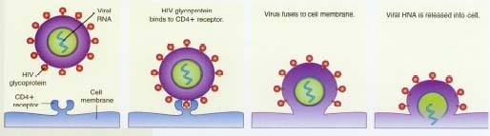
`
HIV
How HIV attacks a cell ???
HIV only infects certain types of cells. In general, these are cells which carry CD4 receptors on their surface.

Slide 15
`
HIV
How HIV attacks a cell ???
Some cells in the immune system have these receptors, in particular, T4-lymphocytes or T-helper cells. These cells are often referred to as CD4 cells or T4 cells. Other cells carrying the CD4 receptor include other white blood cells (monocytes and macrophages), glial cells in the brain, chromaffin cells in the intestines and Langerhans' cells in the skin. All of these cell types have been shown to be infected with HIV. It has also been shown, however, that cells which do not bear the CD4 receptor may still be infected by HIV which raises the possibility that other cellular receptors for the virus may exist.
When HIV comes into contact with T-Lymphocytes(CD4 cells), the spikes of gp120 'slot into' the CD4 receptors (like a lock and key) allowing binding of the virus to the host cell. Once inside the cell, the virus loses its outer envelope and its contents are released into the host cell's cytoplasm, the most important of which, are the viral RNA and reverse transcriptase. Using the viral RNA as a template, reverse transcriptase catalyses the production of a single, complementary strand of DNA from nucleotides in the host cell.

Slide 16
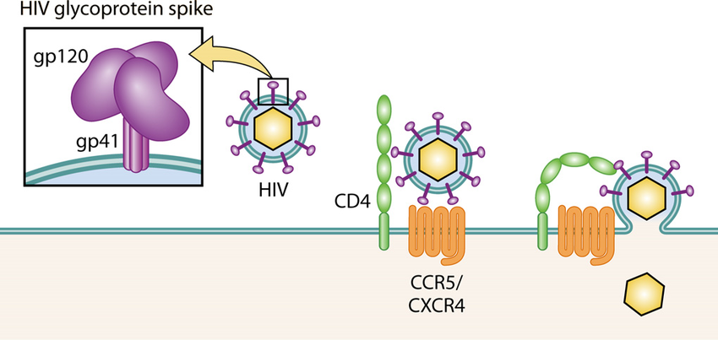
`
HIV
How HIV attacks a cell ???

Slide 17
`
HIV
How HIV attacks a cell ???
DNA is constructed of units called nucleotides. Each nucleotide is made up of a base (either adenine, guanine, thymine, or cytosine), a sugar and a phosphate molecule. The sequence in which the bases occur determines the genetic code of the virus. RNA differs from DNA in that uracil replaces thymine as a base and the sugar molecule is different. Once the single strand of DNA has been produced, it acts as a template in the production of a second strand of DNA. This replication step is also catalysed by reverse transcriptase and the resulting double-stranded DNA is known as proviral DNA. This is then incorporated into the DNA of the host cell by the viral enzyme, integrase. It is this integration of the viral genetic material into the host cell's own genetic material that makes eradication of the virus, without damage to the host cell, a formidable goal.

Slide 18
`
HIV
How HIV attacks a cell ???
Effectively, the virus has now hijacked the host cell's own replication system. As a result, when the cellular DNA is transcribed, so is the viral DNA to form an RNA transcript. Further processing of this RNA into messenger RNA (mRNA) and genomic viral RNA occurs.
The viral mRNA is then translated into viral proteins, which along with the genomic RNA, are assembled into new virus particles. This last stage requires the viral enzyme, protease. Finally, the new viral particles are released from the infected cell and go on to infect other cells in the body.

Slide 19

How it occurs ?
Which are the modes of
Transmission ?
HIV

Slide 20
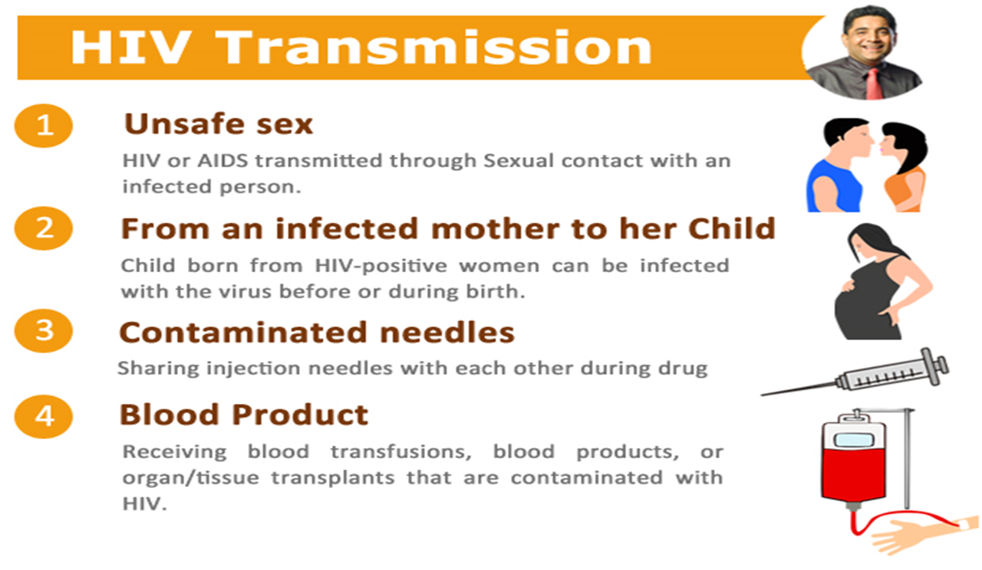

Slide 21
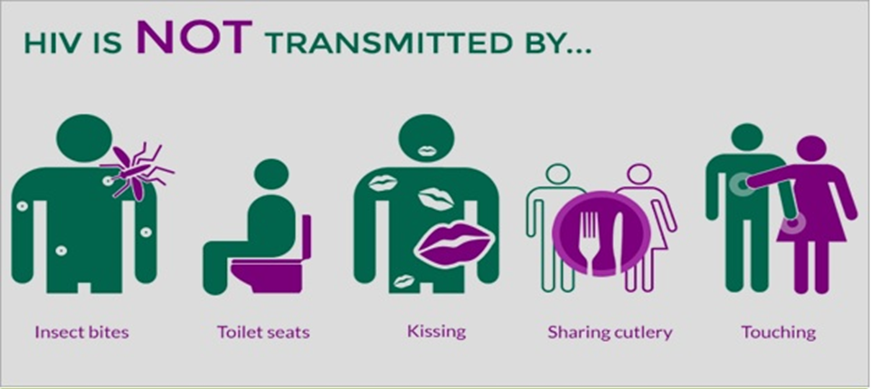
Myths….

Slide 22

How it affects our body ?

Slide 23


What is the solution of HIV?

Slide 24

Antiretroviral Therapy (ART)
-It is the combination of Antiretroviral Drugs.
-There are Several types of Antiretroviral Drugs who can reduce the rate of HIV different different way.
- Antiretroviral treatment reduces the HIV viral load in the blood, semen, vaginal fluid and rectal fluid to very low levels or you can say undetectable levels, decreasing the risk of onwards HIV transmission

Slide 25

Treatment as prevention (TasP) for HIV :
1. Prevention of mother-to-child transmission (PMTCT) :-
-Reduce the rate of HIV transmission from
mother to child

Slide 26

2. Pre-exposure prophylaxis (PrEP) :-
-For those people who has the chance to get HIV.
-In,2015 WHO has declared that t if Person has substantial risk of HIV infection then PrEP would be offered to that person.
- In past, it was for only some key affected population like sex workers, person who has sex with HIV infected person and people who inject drugs in their body.

Slide 27
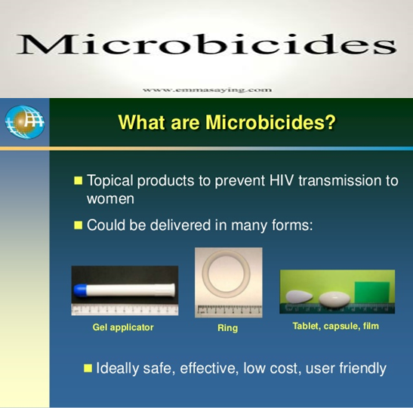
3. Microbicides
-These are gels or creams containing antiretroviral drugs that are applied to the vagina to help prevent HIV infection.

Slide 28

4. Post-exposure prophylaxis (PEP)
-It is short-term antiretroviral treatment taken after possible exposure to HIV.
-Since 1998, Health Care workers have used it. Who were exposed to HIV-infected fluids
-Recently, This method has been used to treat those who may have been exposed during a single event (for example sexual assault, unprotected sex or sharing drug injecting equipment).

Slide 29

Test and treat strategies :-
-This strategies are based on the premise that the rate of new HIV infections can be reduced by rolling out universal HIV testing in order to diagnose all people living with HIV, and initiate antiretroviral treatment regardless of CD4 count or viral load.
-One case study which performed in south africa analised that the implementation of universal voluntary HIV testing for adults over 15 years old would decrease HIV prevalence to 1 %.

Slide 30
Detail of Case Study :-
-Name : Test and Treat in Hlabsia
-The first of five massive randomized studies into test and treat strategies took place between 2012 and 2016. ANRS 12249 was covering a poor rural area of KwaZulu-Natal, where three out of ten people are living with HIV which was the highest prevalence in South Africa. The main agenda of the research was to check the population impact of scaling up treatment as prevention, where By antiretroviral treatment (ART) is used to decrease individual’s viral load and thereby decrease the risk of onward HIV transmission.
- Medical management of these areas was not so good that's why only 49%.

Slide 31

What are the Limitations …?? How can we overcome that ??

Slide 32

1. Treatment as prevention is not 100 percent effective
2. Regularity is important to its success
3. Multidrug-resistant HIV

Slide 33
The future of treatment as prevention :-
- TasP has a lot of potential in decreasing population level rates of HIV transmission by increasing uptake of HIV testing, offering treatment and linking people to care.
-Its effectiveness depends on the on the willingness and ability of people
-Main Challenge is its implementation with limited resource. It's depends on the country's Medical system to provide effective treatment.
-Overall, there is huge support for treatment as an HIV prevention measure. With only treatment we can not defeat this big giant called HIV.we also need to spread Social awareness among the People about HIV.

Slide 34

Genome editing and CRISPR/Cas9

Slide 35
What is Genome editing and it’s importance?
Genome editing is a type of genetic engineering in which DNA is inserted, deleted or replaced in the genome of a living organism using engineered nucleases, or "molecular scissors.“
These nucleases create site-specific double-strand breaks (DSBs) at desired locations in the genome.
The induced double-strand breaks are repaired through nonhomologous end-joining (NHEJ) or homologous recombination (HR), resulting in targeted mutations ('edits').

Slide 36
Genome editing systems
All genome editing systems contain a nuclease part to cut the DNA and a DNA-targeting part to recognise the DNA sequence they cut.
They mainly differ in how they recognise the DNA to cut:
RNA based: contain a short sequence of RNA that binds to the target DNA to be cut.
Protein based: contain a protein that recognises and binds to the target DNA to be cut.

Slide 37
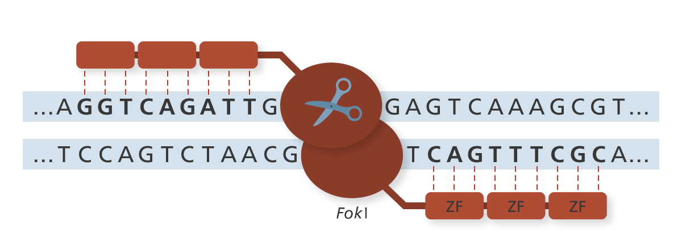
ZFNS(zinc-finger nucleases)

Slide 38
ZNF has DNA-binding part , which is made of zinc-finger proteins.
Each zinc-finger protein binds to different sequences of DNA.Different combinations of zinc-finger proteins bind with different sequences of DNA, But it is hard to predict without testing them first.
The nuclease part of ZFNs is generally a FokI nuclease and it cuts the DNA.
Two FokI molecules bind together to make a cut in the DNA, so this way a pair of ZFNs are made and one binds to each strand.

Slide 39
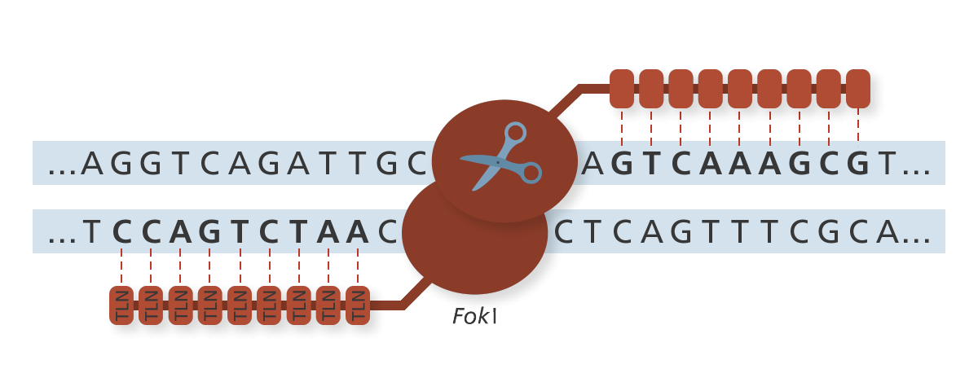
TALENs (Transcription activator-like effector nucleases)

Slide 40
TALENs has DNA-binding domain, which is made of TALE(Transcription activator-like effector).
There are four types of Binding domain, each domain for each DNA base. so they can be programmed to bind to specific DNA sequences much more easily than ZFNs.
Same as ZFNs, the nuclease part of TALENs is generally FokI nuclease.
Two FokI molecules must have to come together to do a cut in the DNA, so two TALENs can be maid, one TALENs binds with each strand.

Slide 41
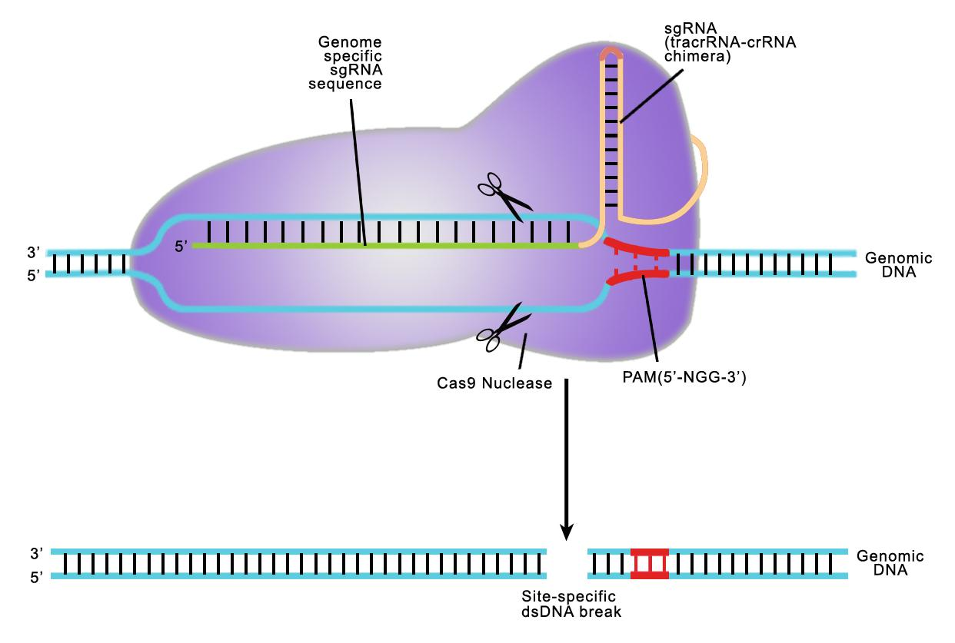
CRISPR-Cas9

Slide 42
CRISPR-Cas9 is the most common, cheap and efficient system used for genome editing.
CRISPR stands for ‘Clustered Regularly Interspaced Short Palindromic Repeats’.
CRISPR is the DNA-targeting part of the system which consists of an RNA, molecule, or ‘guide’, designed to bind to specific DNA bases through complementary Base-pairing.

Slide 43
CRISPR are segments of prokaryotic DNA that contain repetitive palindromic base sequences separated by short segments of spacer DNA.
There are also a number of genes associated with the CRISPR. These are known as the CRISPR Associated (CAS) genes.
Cas9 stands for CRISPR-associated protein 9, and is the nuclease part that cuts the DNA.
The CRISPR-Cas9 system was originally discovered in bacteria that use this system to destroy invading viruses.

Slide 44
APPLICATIONS of CRISPR/CAS9
Using CRISPR/CAS9 one can insert, delete and modify DNA in human genome and animals.
CRISPR/CAS9 technique can be used to cure a rare liver disease, cancer and HIV.
CRISPR/CAS9 technique is used to eliminate muscular dystrophy in mice.
CRISPR is used to create transgenic animals such as pigs,zebrafish,rat and mice.
Food manufacturing companies are using this technique to produce cheese and yoghurt.
Using this technology we can improve the quality and life of rice, tomato and tobacco etc.

Slide 45
Advantages of CRISPR Genome
Target design simplicity : Because the target specificity relies on ribonucleotide complex formation and not protein/DNA recognition, gRNAs can be designed readily and cheaply to target nearly any sequence in the genome specifically.
It is more Efficient and simple technique compared to other Gnome technology.

Slide 46
We can direct inject it in Embryo. It reduces the time required to modify target genes compared to gene targeting technologies based on the use of embryonic stem (ES) cells.
CRISPR uses advanced bioinformatics tools to identify the most appropriate sequences to design guide RNAs and optimization of the experimental conditions enabled very robust procedures which guarantee successful introduction of the desired mutation.
Multiplexed mutations : Mutations can be introduced in multiple genes at the same time by injecting them with multiple gRNAs.

Slide 47
Disadvantages/limitations of CRISPR Genome
If guide RNA bound with wrong DNA let say bacterial DNA then cas9 would destroy that DNA. It would harmful for body.
Off-site effects : Mutation introduced at non-specific loci with similar, but not identical, homology to the target sites are one of the most important complication of these technologies.
Mosaicism : the property or state of being composed of cells of two genetically different types.

Slide 48
Other methods
We have referred two research papers to know about CRISPR/Cas system’s applications:
Genome editing –a technology in time for plants
By Sunghwa Choe (Seoul National University, South Korea)
Various research papers and websites related to CRISPR/Cas9 genome editing technique and its application in site-directed genome modification of animals.

Slide 49
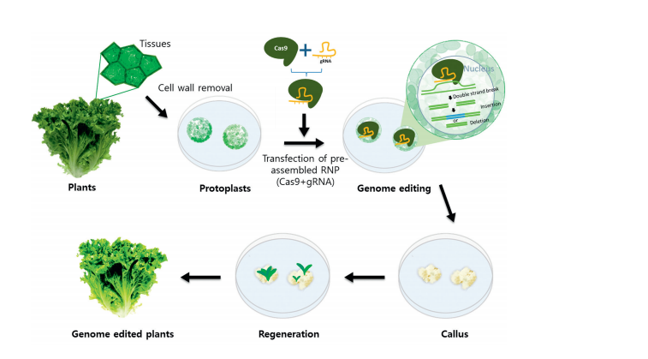
Genome editing –a technology in time for plants
. Cas9 protein-based genome editing in plant cells

Slide 50
Figure in previous slide describes Cas9 protein-based genome editing in plant cells.
Protoplasts (cells lacking a cell wall) were prepared by treatment with cell wall-digesting enzymes.
Cas9 protein and gRNA were independently prepared and assembled in vitro before being introduced into the protoplasts.

Slide 51
The protoplasts divided after recovering their cell wall. Dividing cells formed callus (a mass of undifferentiated plant cells).
Independent calli derived from a single protoplast were tested for successful genome editing by Polymerase Chain Reaction (PCR), Restriction Fragment Length Polymorphism(RFLP) and deep sequencing. Whole plants were regenerated from the mutation-bearing calli.

Slide 52
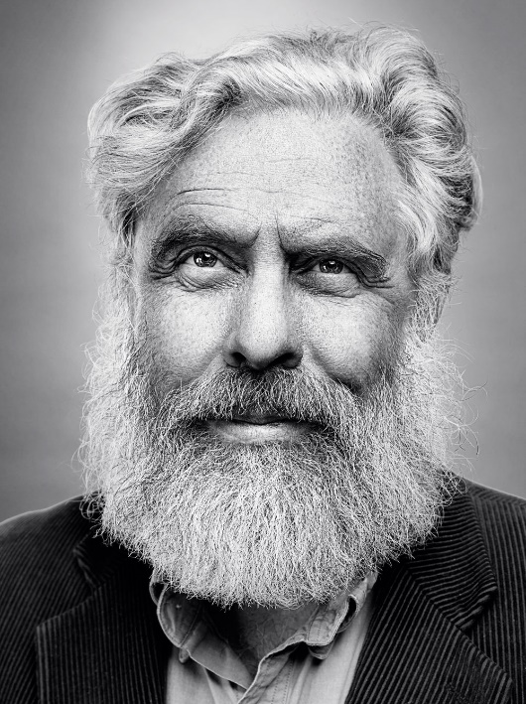

Mammoth genomes provide recipe for creating Arctic elephants !!
George Church
A hybrid of a mammoth and an elephant could be created within two years, scientists say

Slide 53
Using the CRISPR DNA editing technique, his group spliced genetic segments from frozen mammoth specimens, including genes from the ears, subcutaneous fat, and hair attributes, into the DNA of skin cells from a modern elephant.
This marked the first time that woolly mammoth genes had been functionally active since the species became extinct.

Slide 54
Church helped develop the most widely used technique, known as Crispr/Cas9, that has transformed genetic engineering since it was first demonstrated in 2012.
Church, a guest speaker at the meeting, said the mammoth project had two goals: securing an alternative future for the endangered Asian elephant and helping to combat global warming.
Woolly mammoths could help prevent tundra permafrost from melting and releasing huge amounts of greenhouse gas into the atmosphere.

Slide 55

PROs and cons….

Slide 56


Pros…
-Cure diseases like Cancer , HIV , AIDS.
-By mutation we can create super Human. Like we can set the gens as someone who can be super powerful at mental level or Physical level.
-We can reverse the process of Human life cycle.
-By Using this we can make Human immoral.
-We can also use this technology on animals such then we can create healthy animals to eat. Like Pig, Salmon fish, Chicken etc.

Slide 57



Cont...
We can also use this technology on animals such then we can create healthy animals to eat. Like Pig, Salmon fish, Chicken etc.
-We can also apply this technology to Farming to produce good quality of food.

Slide 58
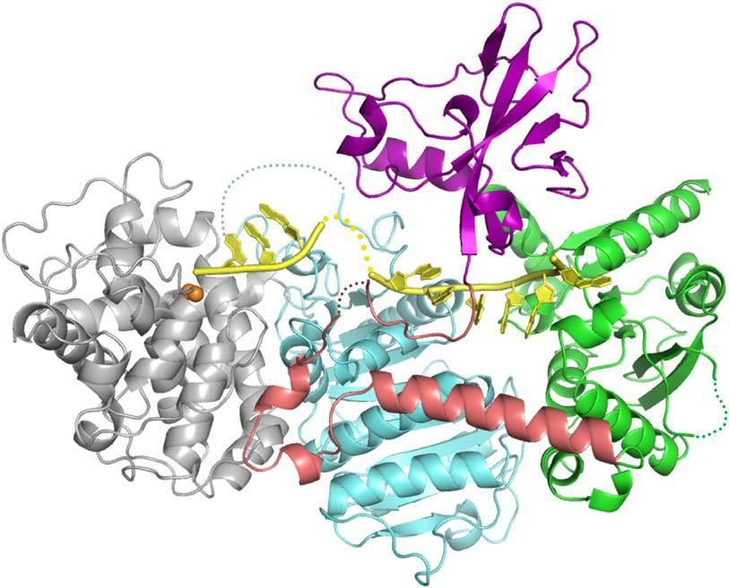




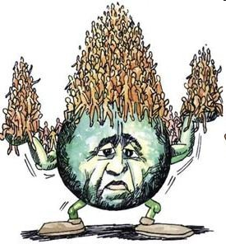

Cons
-Very Complex. Needs High Level of accuracy. If Something goes wrong then Condition becomes worst than earlier .
-Wrong Usage Of Technology would be harmful for whole Humanity
-Immortality leads towards Overpopulation
-UnEthical

Slide 59
But why isn’t CRISPR ready for prime time?
CRISPR still has a long way to go before it can be used safely and effectively to repair—not just disrupt—genes in people.
That is particularly true for most diseases, such as muscular dystrophy and cystic fibrosis, which require correcting genes in a living person because if the cells were first removed and repaired then put back, too few would survive.
the need to treat cells inside the body means gene editing faces many of the same delivery challenges as gene transfer—researchers must devise efficient ways to get a working CRISPR into specific tissues in a person, for example.

Slide 60
CRISPR/Cas9 : HIV Treatment Applications
Approaches:
Two main approaches are used to tackle hiv using Crispr/ Cas9 system.:
Removing Proviral DNA from the T cell DNA.
Editing or disrupting CCR5 gene from the T cells

Slide 61
Removing Proviral DNA from T cell DNA
The proviral reverse transcription DNA integrated into the host genome is an important step during HIV-1 life cycle
This virus sometimes becomes transcription inactive and takes latent form
Many studies have been done in labs with promising results concluding that latent HIV-1 proviral DNA can be disrupted enough so that it becomes inactive.
Here we review two studies using CRISPR/Cas9 system:
Harnessing the CRISPR/Cas9 system to disrupt latent HIV-1 provirus
Hirotaka Ebina, Naoko Misawa, Yuka Kanemura & Yoshio Koyanagi
2. The CRISPR/Cas9 system inactivates latent HIV-1 proviral DNA
Weijun Zhu, Rongyue Lei, Yann Le Duff , Jian Li , Fei Guo , Mark A Wainberg & Chen Liang

Slide 62
Review: Harnessing the CRISPR/Cas9 system to disrupt latent HIV-1 provirus
gRNA generation
Test subjects : 293 T and HeLa cells
Nucleo Transfection
Testing Genome Editing
Results
Conclusion

Slide 63
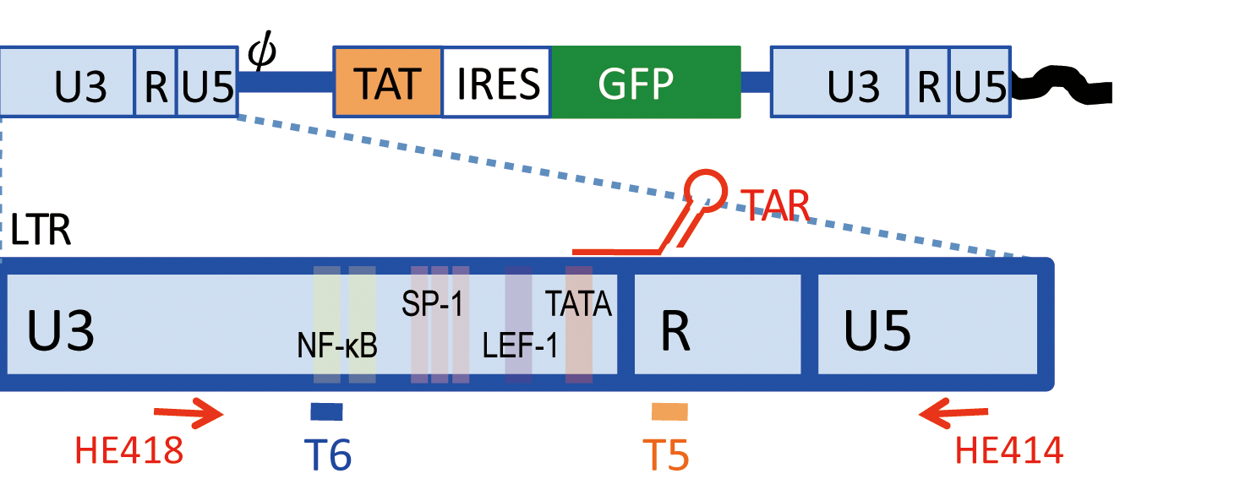
gRNA generation

Slide 64
Test Subjects
293 T and HeLa(Henrietta Lacks) cells were infected with an LTIG vector pseudotyped with VSV-G(Vesicular stomatitis Indiana virus G) envelope protein to serve as the test subjects for the CRISPR/Cas9 system.

Slide 65
Nucleo Transfection
These cells were transfected with T5 or T6 expression plasmid along with hCas9 plasmid.

Slide 66
Testing Genome Editing
Mean fluorescence intensity(MFI) of GFP(Green Fluorescent Protein expression was analysed by flow cytometry

Slide 67
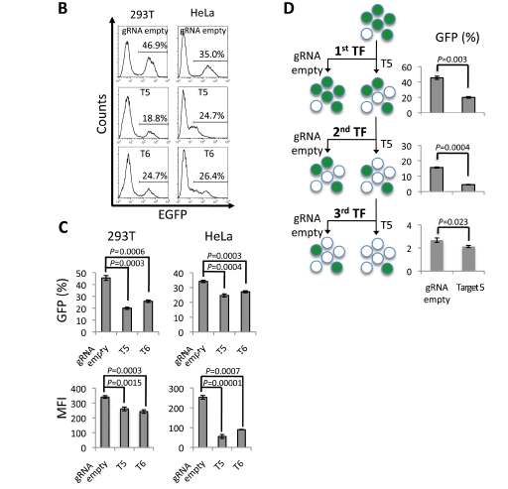
Results

Slide 68
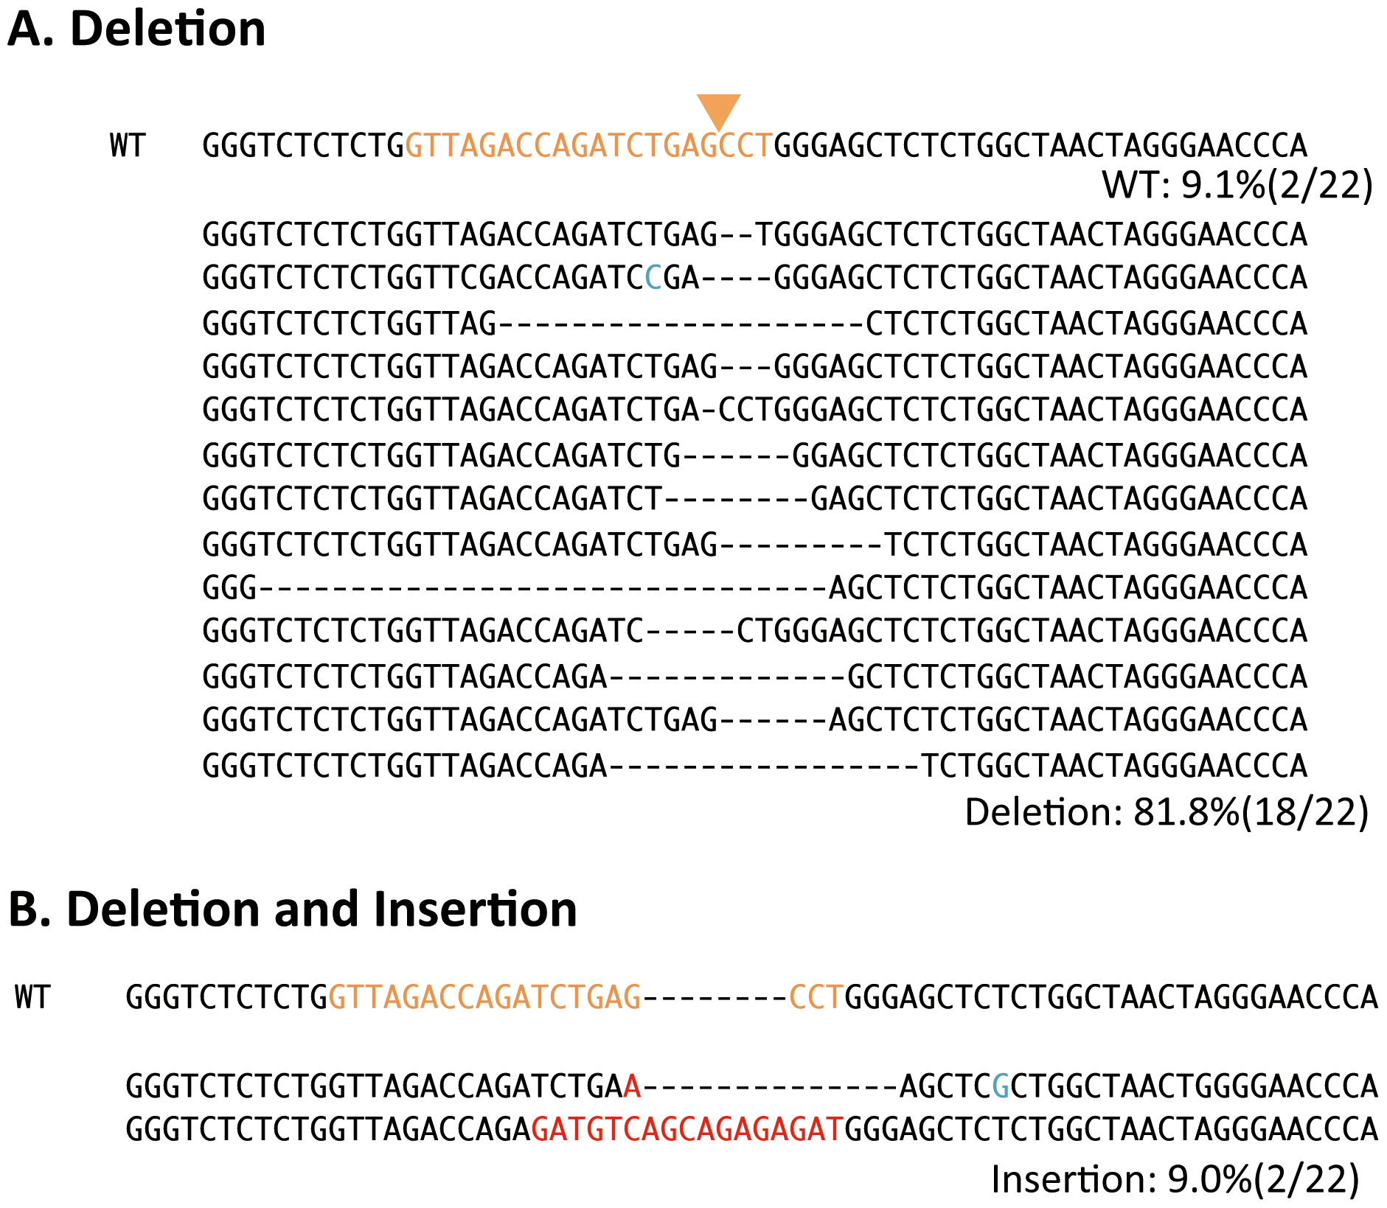
Results (contd.)

Slide 69
The CRISPR/Cas9n system inacitivates latent HIV-1 proviral DNA
gRNA generation
Test subjects :JLat10.6 Jurkat cell
Nucleo Transfection
Testing Genome Editing
Results
Conclusion
Notes:
The CRISPR/Cas9 system inactivates latent HIV-1 proviral DNA

Slide 70
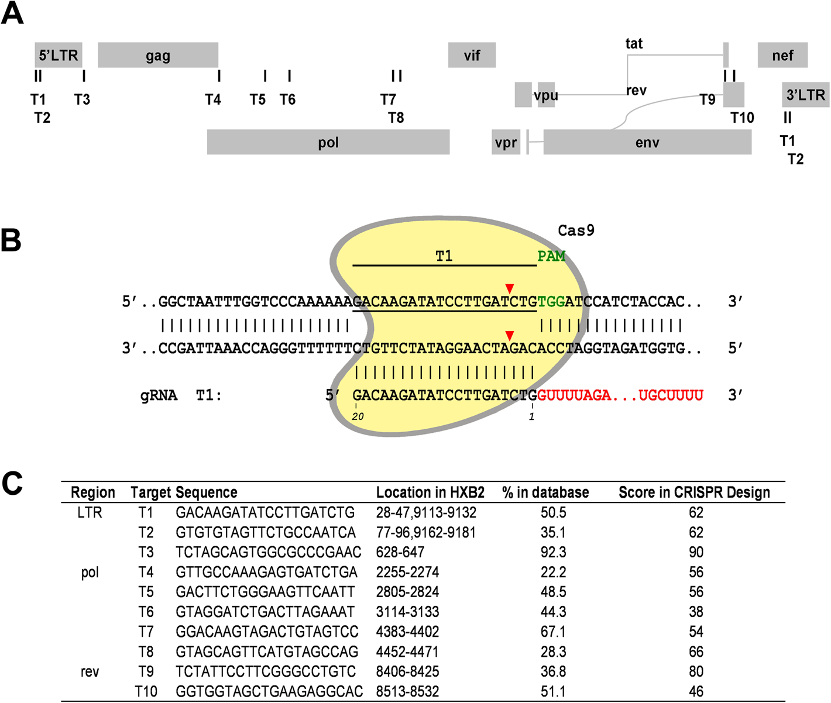
gRNA generation

Slide 71
Test subjects
Jurkat cell line called JLat10.6 developed to study HIV-1 latency is used a test subject for the CRISPR/Cas9 system.
The GFP has been inserted as a reporter gene which is expressed on treatment of the JLat10.6 cells with cytokines such as TNF-alpha

Slide 72
Nucleo Transfection
These gRNA constructs along with the human Cas9 plasmid DNA was transfected into nucleus

Slide 73
Testing Genome Editing
The cells were treated with cytokine TNF-α (10 ng/ml) treatment to induce viral gene expression which is monitored by scoring GFP-positive cells by flow cytometry.

Slide 74
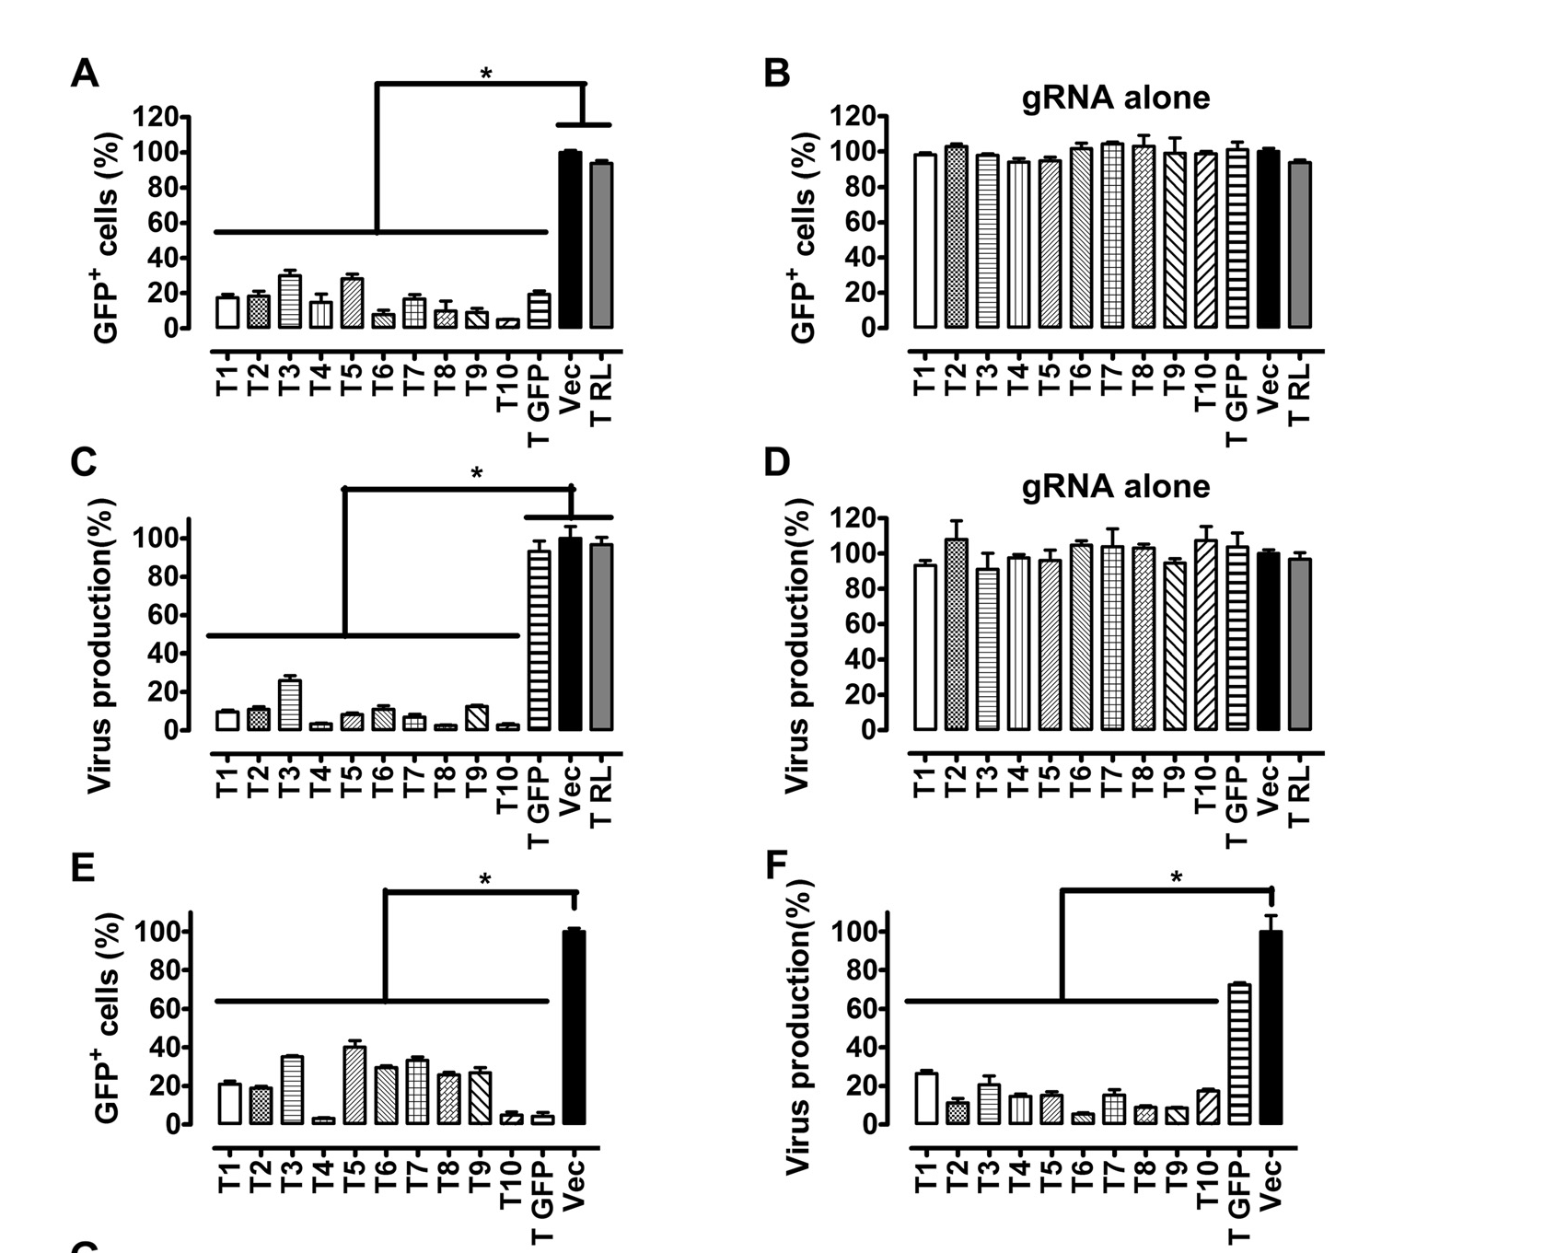
Results

Slide 75
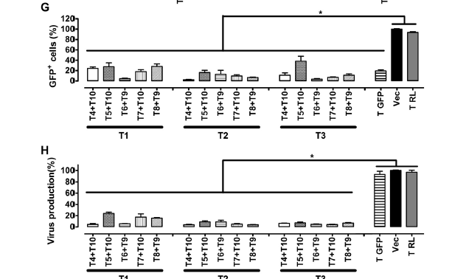
Results(contd.)

Slide 76
Conclusion
CRISPR/Cas9 system targets and inactivates HIV-1 proviral DNA in the latent JLat10.6 celline.

Slide 77
Editing or disrupting CCR5 gene from the T cells
The C-C chemokine receptor type 5 (CCR5) is the major coreceptor used by HIV-1 to infect T cells, macrophages, and their cell types. Individuals who are heterozygous(different allele) or homozygous(same allele) for the CCR5Delta32 mutation in the CCR5 gene have slower progression or resistance to HIV infections
Many studies have been undergone on disabling the CCR5 gene in CD34+ hematopoietic stem progenitor cells (HSPCs) or CD4+ T cells using shRNA or by gene disruption using zinc finger nucleases (ZFNs)
Here we discuss the CCR5 disruption in HeLa derived cells carried out in the study :
Inhibition of HIV-1 infection of primary CD4+ T-cells by gene editing of CCR5 using adenovirus-delivered CRISPR/Cas9.

Slide 78
Review : Inhibition of HIV-1 infection of primary CD4+ T-cells by gene editing of CCR5 using adenovirus-delivered CRISPR/Cas9
gRNA generation
Test Subjects (TZM bl cells)
Nucleo Transfection
Results
Testing Off-Target Editing
Conclusion

Slide 79
Test Subjects
The HeLa cell derivatives TZM -bl cells were used.

Slide 80
Nucleo transfection
HeLa-derived t cells were infected with LentiCRISPR expressing Cas9 and sgRNA.
Then the DNA was extracted and the 1228 bp fragment encompassing the CCR5 ORF was amplified (multiple copies made).

Slide 81
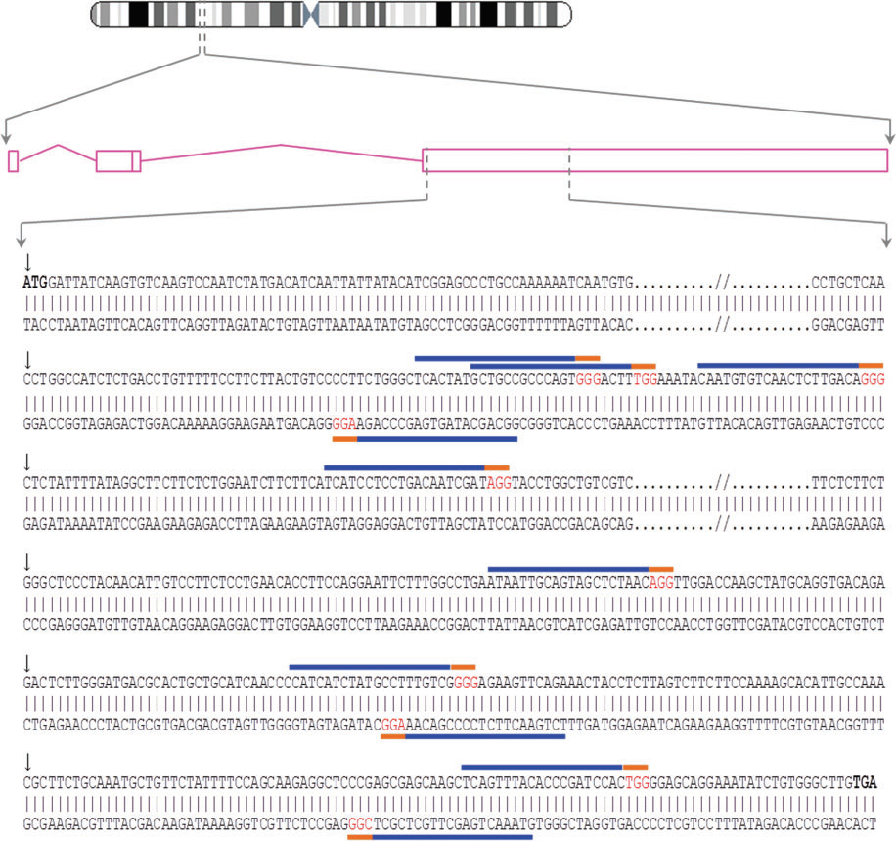
gRNA generation

Slide 82
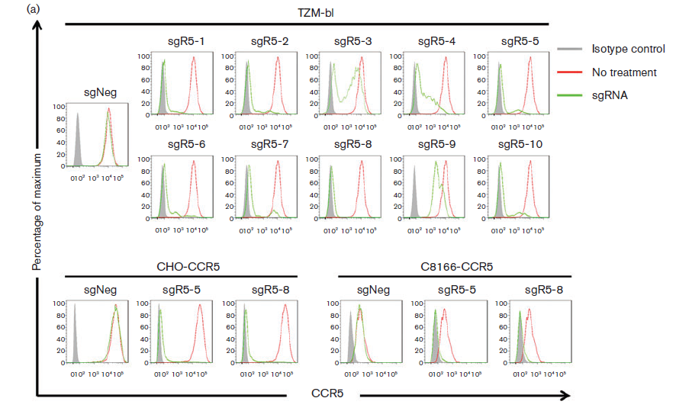
Results

Slide 83
Testing Off Target Editing
The 15 top-ranked off-target sites in the whole human genome were analysed. Approximate 500 bp segments spanning the potential off target sites were amplified from genomic DNA of TZM bl cells and subjected to T7EI analysis.

Slide 84
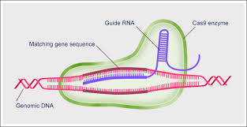
How CRISPR-Cas9 sometimes fail in tackling HIV
I studied a research paper titled: CRISPR/Cas9: a double-edged sword when used to combat HIV infection written by Liang, Wainberg et al.
LVR (latent viral reservoir) is a major hindrance in complete removal of HIV from the body which exists inspite of the highly active antiretroviral therapy better known as HAART.

Slide 85
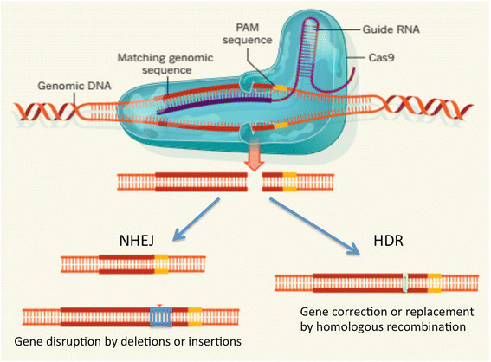
How CRISPR-Cas9 sometimes fail in tackling HIV
The helicase divides the strands while the nuclease cuts the strand at specific location decided by gRNA.
The most commonly attacked cells are CD4+ T cells. But as these methods promises, to inactivate/ delete proviral DNA from HIV-1 infected cells, quite a few times, anomaly is observed

Slide 86
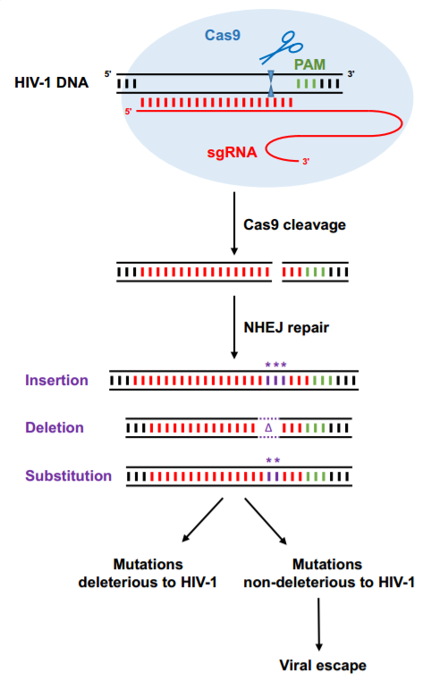
Experiments were carried out for HIV-1 evolution on CD4+T cells and it was found out that for some time the number of HIV-1 infections were reduced but after some time, high level of infections were observed.
It was observed that for non-conserved HIV-1 sequences, rapid escape was seen but when more conserved viral DNA sequences where tested, a slow rate of escape was seen.

Slide 87
most of the mutation process by HIV-1 on proviral DNA was found at the point where Cas9 was designed to cleave it.
This was done by non-homologous end joining(NHEJ) machinery whose main task is to repair broken DNAs
Off these, some repeal the functions of HIV-1 proviral DNA and hence are not selected.

Slide 88
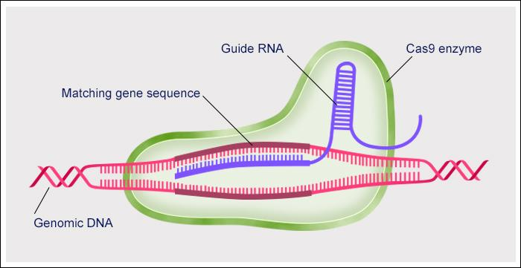
Preventing escaping by design of gRNAs that effectively target the HIV-1
DNA genome
I studied another research paper titled CRISPSR-Cas9 can inhibit replication but NHEJ repair facilitates virus escape written by Wang, Zhao et al.
Thus Wang, Zhao et al. discussed an interesting theory for prevention of this attack. They used the special silico algorithms.
According to their algorithm, 7 gRNAs were specifically selected for LTR region

Slide 89
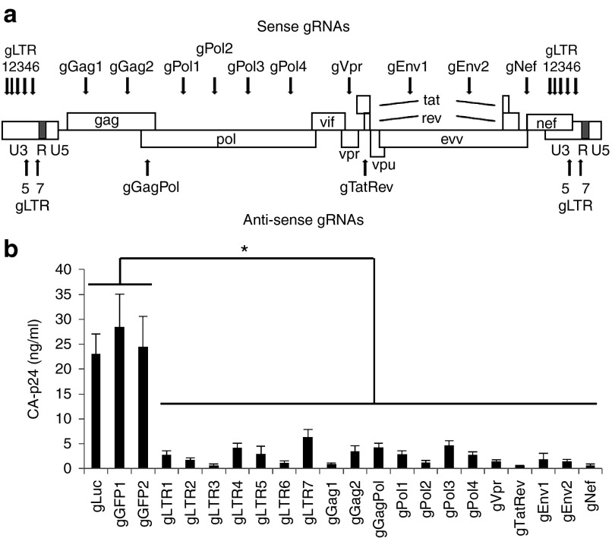
They targeted the long terminal repeat present at 5 and 3 ends of the proviral genome as shown in the ‘a’ part of the figure.
They also tested the antiviral activity in transient transfections of 293T cells with plasmids expressing HIV-1, cas9 as well as control gRNAs targeting non-HIV sequences.

Slide 90
Some other preventive measures in proviral DNA escaping
Program cas9 with multiple sgRNAs
Regular antiviral drugs and RNAi-mediated gene therapy can be used to suppress viral replication.
Programming cas9 such that they are able to cleave DNA outside of the target sequence
The newly discovered cripsr enzymes like Cpfl can be used.

Slide 91
Conclusion
The papers discussed and the intensive research that has been done in this project has led us to conclude that CRISPR/Cas9 system can be successfully used to edit important sequences of HIV-1 DNA as well cause disruptions and mutations in CCR5 locus which can in turn lead to cure and prevention of HIV in HIV-affected host.Certain studies have been done on mice by developing rat and mouse models.Humanized models have also been tried out by transplanting human immune cells into the mice and then infecting the mice with HIV-1. Then CRISPR/Cas9 system is used as mentioned in studies. These kind of studies using humanized models and animal models have been successful and has given positive affirmations about human trials using CRISPR/Cas9 system for treatment of HIV. Already many human trials for cancer patients have undergone that have used CRISPR/Cas9 system and had overall positive results.

Slide 92
Conclusion
In the later section we discussed a research paper which elaborated the drawbacks of cas9 system in tackling HIV-1. We learnt that no doubt CRISPR does its job of detecting proviral DNA, some sequences escapes. This is more observed in less conserved HIV domain. The incoming proviral sequence is modified ie either by addition or subtraction or substitution in its gene sequence right before PAM works on it and it is compared with the gRNA. What we learned was that the HIV-1 sequence mutated itself such that it went unrecognized by gRNA. Now only those mutations are selected by HIV-1 which shows a modification in its gene sequence and goes undetected as well as they must show its HIV-1 domain specific properties. This was a major drawback of cas9 system. To combat this various research groups have worked on it and have proposed interesting solutions but none are up to the mark. We discussed one such paper where it is shown that using the special silica algorithm, and taking 19 gRNA sequences such that a variety of modifications undergone by the proviral DNA are detected by the cas9 system. Disadvantages here were sometimes normal functioning DNAs were caught while modified HIV-1 got escaped. We finally conclude that CRISPR-CAS9 system is really a milestone in the field of synthetic biology with tremendous significance. With its applications varying from curing blindness to curing HIV to gene editing, its importance is sure to increase in the world. Considering tackling HIV, it is one of the promising methods currently explored by scientists and even though it gets duped by HIV and doesn't prove much efficient, new and new methods are being researched and who knows, a generic and complete cure of HIV-AIDS can be achieved by CRISPR-Cas9 system.

